Slide 1
Intro to Augmented Reality
Immersive Experiences Lab

Slide 2
What is Augmented Reality?
an enhanced version of reality created by the use of technology to overlay digital information on an image of something being viewed through a device (such as a smartphone camera)

Slide 3
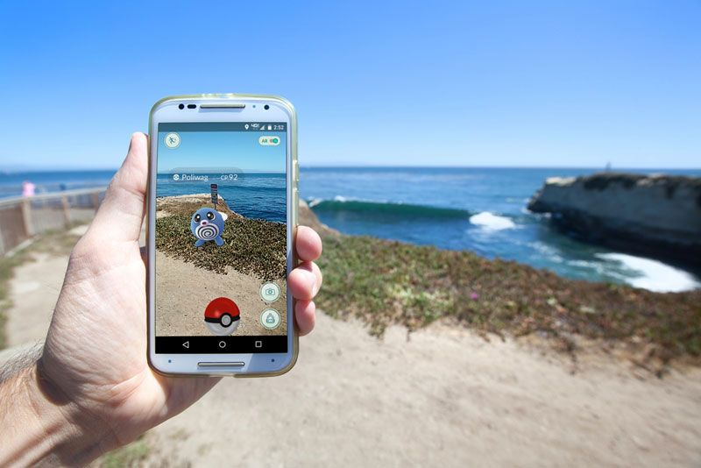
What is Augmented Reality?

Slide 4
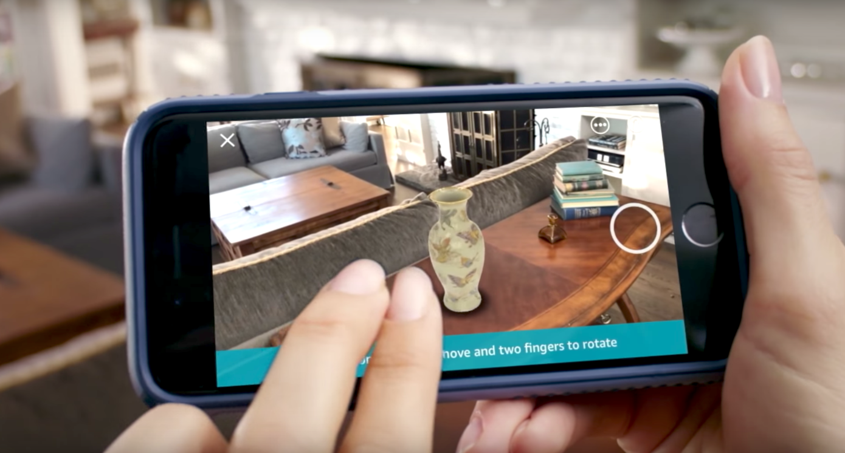
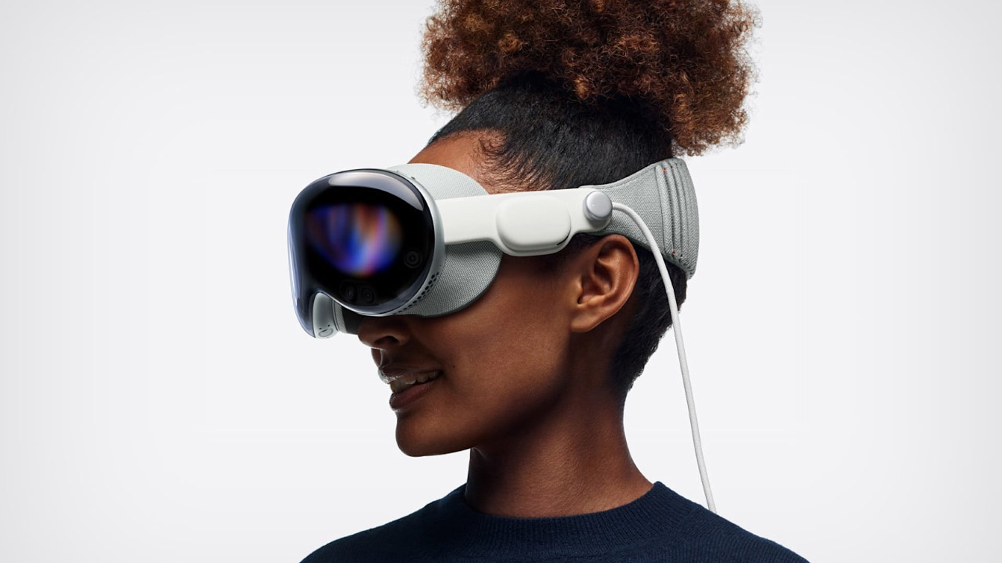
How is AR Consumed
Amazon AR Shopping Feature
Apple Vision Pro

Slide 5
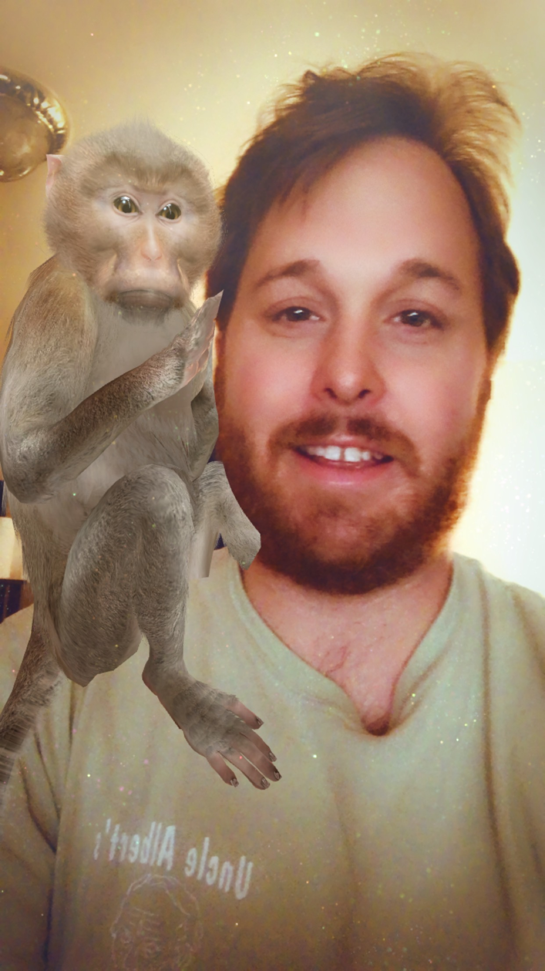
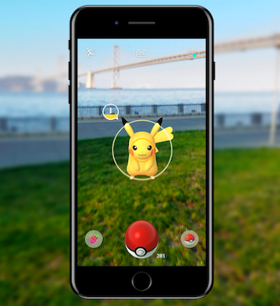
How Is Augmented Reality Being Used?
Entertainment
Pokemon Go and other games
Face filters (E.G snapchat)

Slide 6
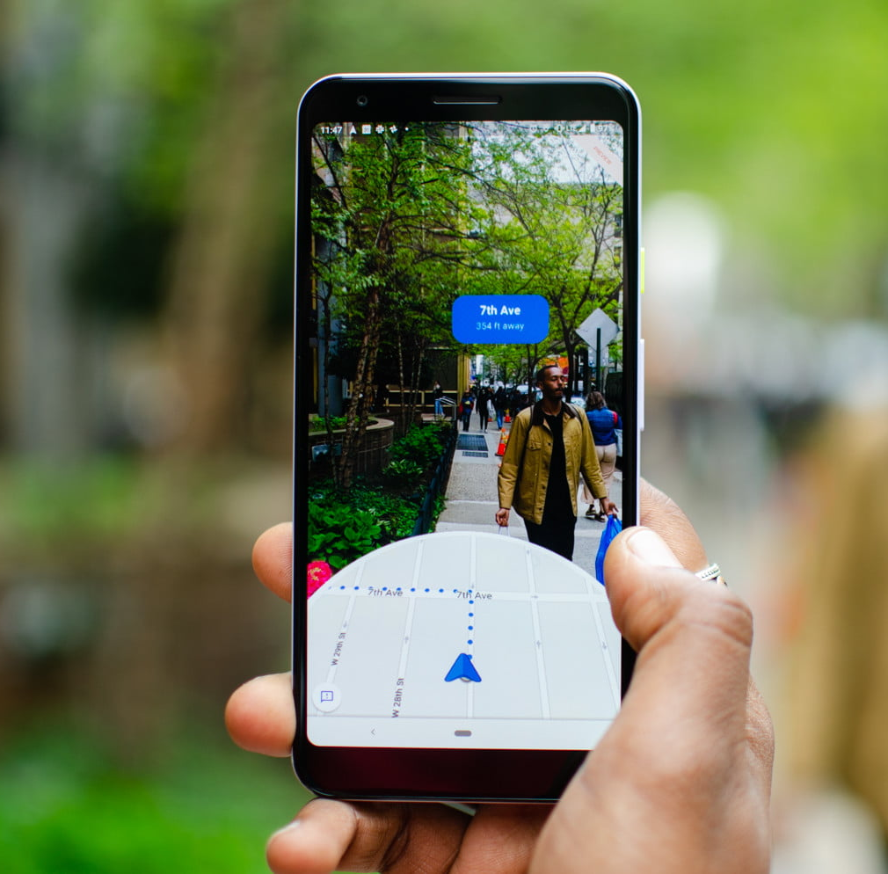
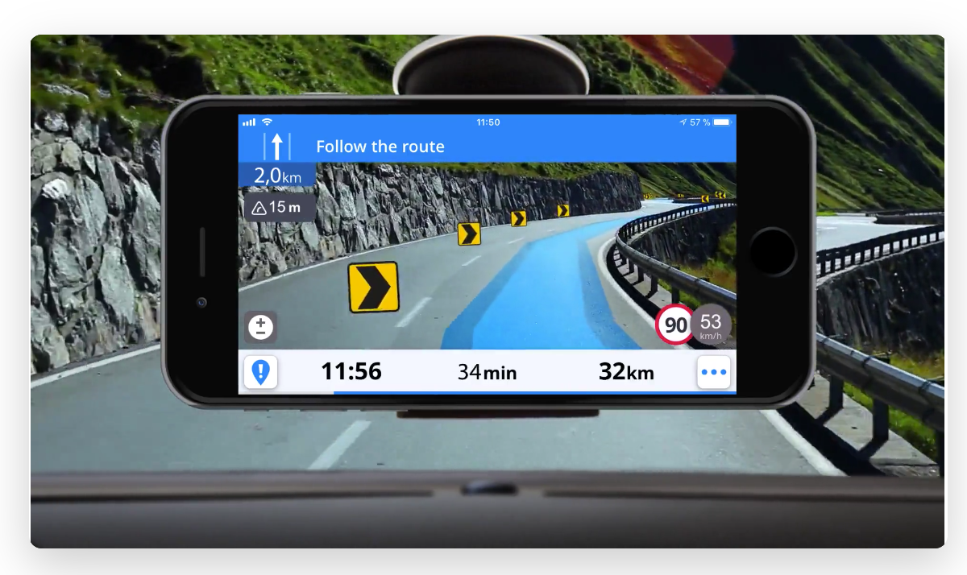
How Is Augmented Reality Being Used?
Navigation Systems
Sygic
Google Maps AR

Slide 7
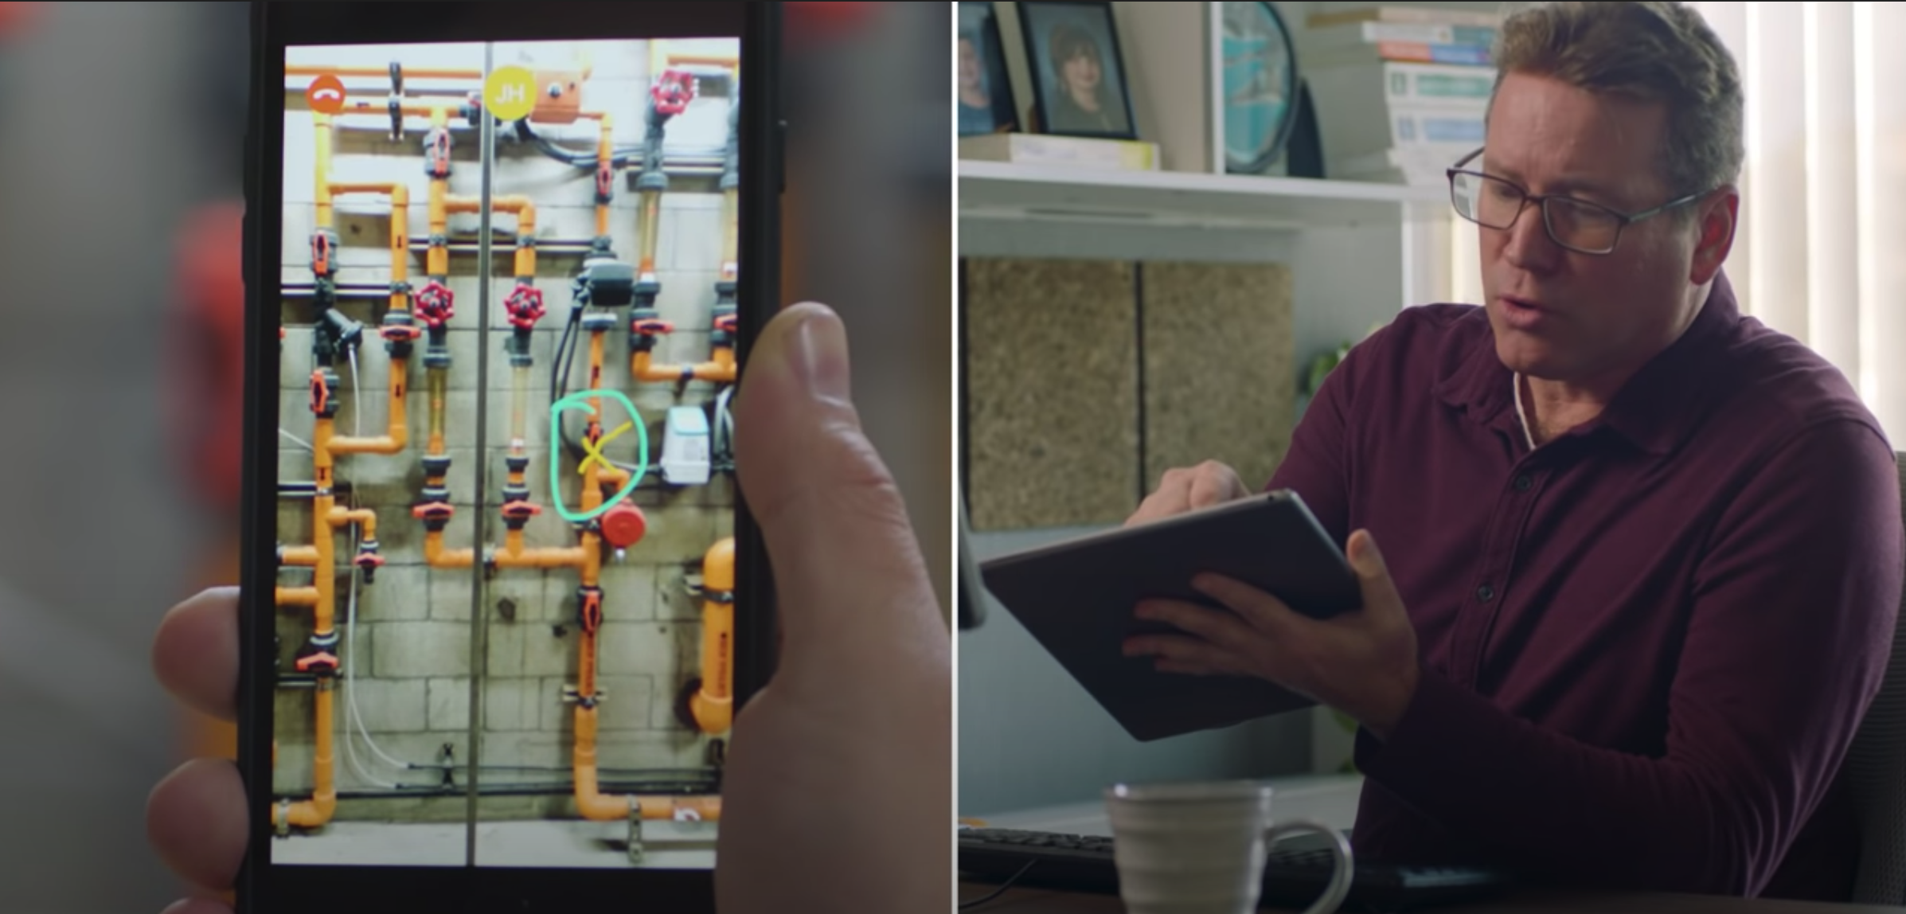
How Is Augmented Reality Being Used?
Maintenance & Remote Assistance - https://www.youtube.com/watch?v=b6DFbMoks-8

Slide 8
How Is Augmented Reality Being Used?
Architecture
Ability to visualize blueprints in AR

Slide 9
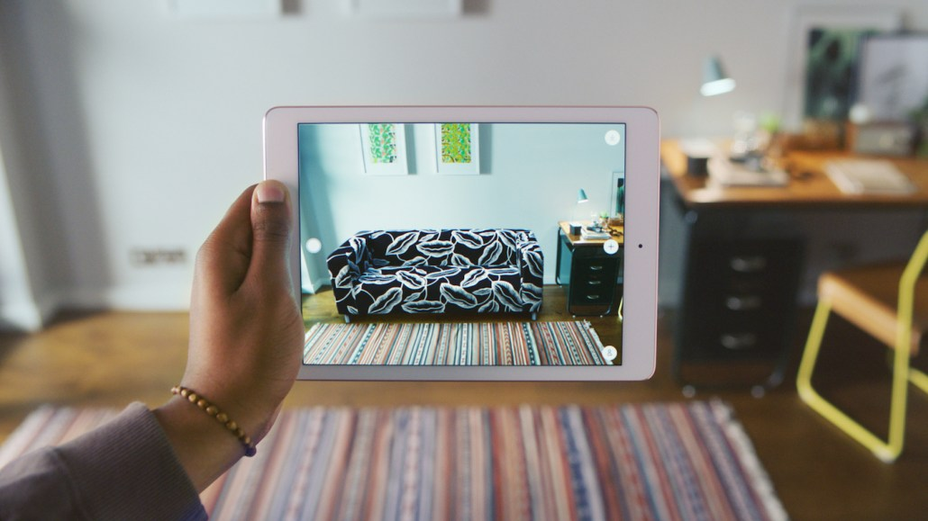
How Is Augmented Reality Being Used?
Retail Shopping
Companies use AR as a way to let customers preview how things will look in their home

Slide 10
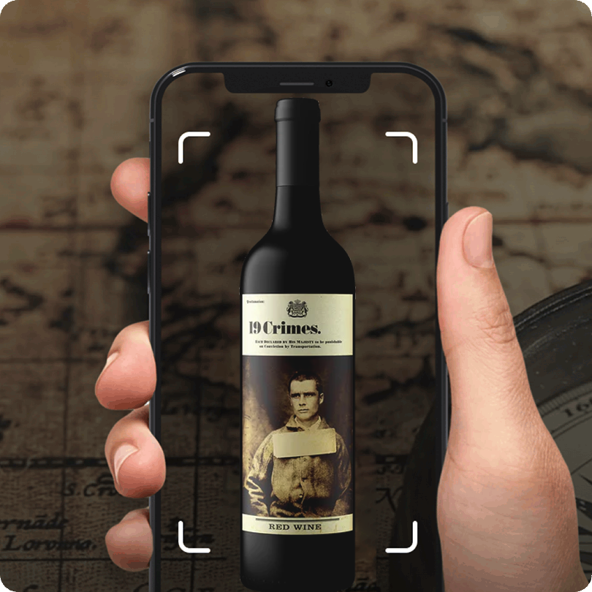
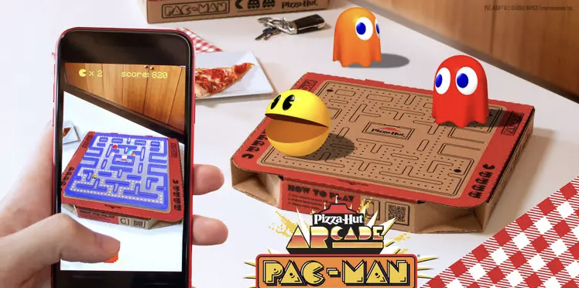
How Is Augmented Reality Being Used?
Marketing

Slide 11
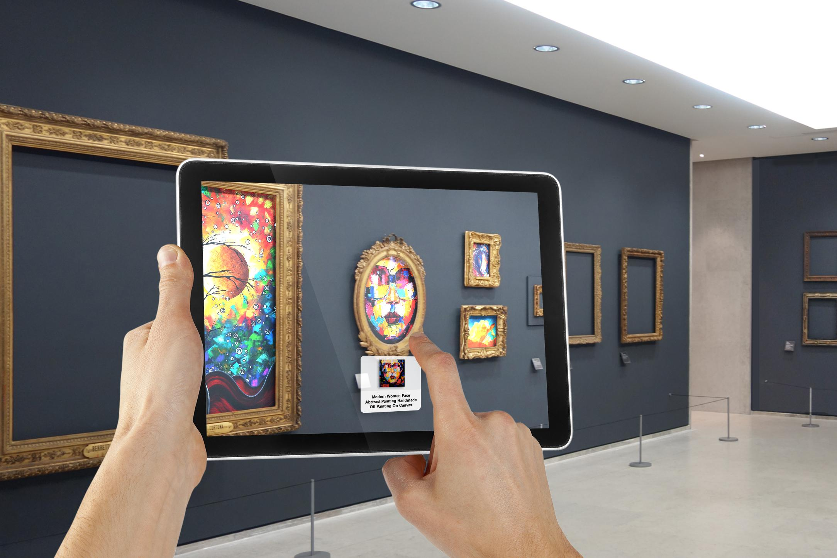
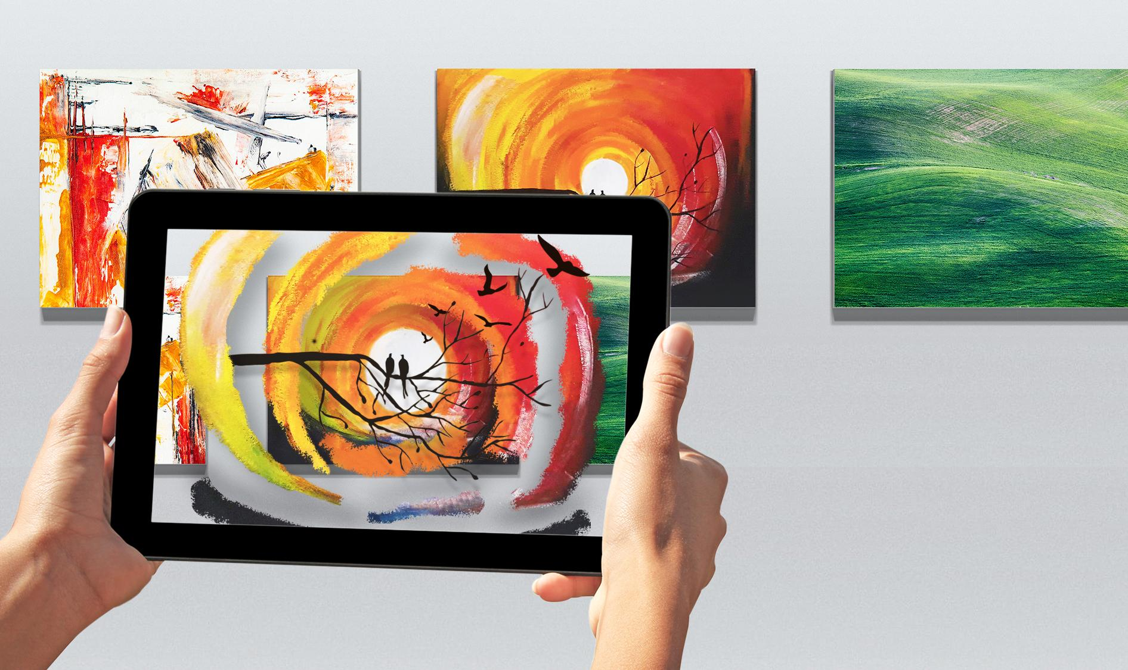
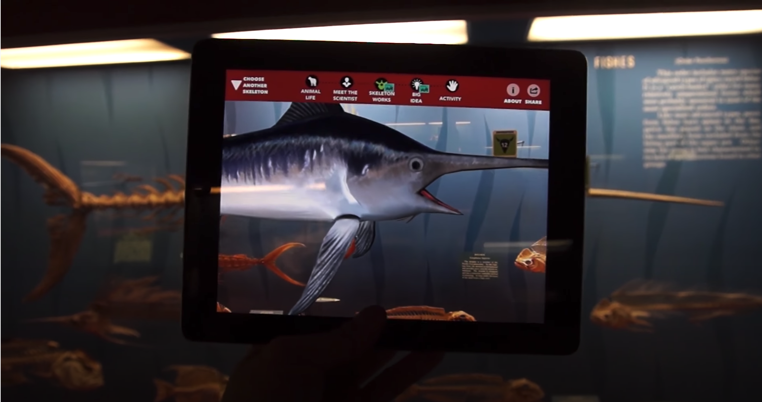
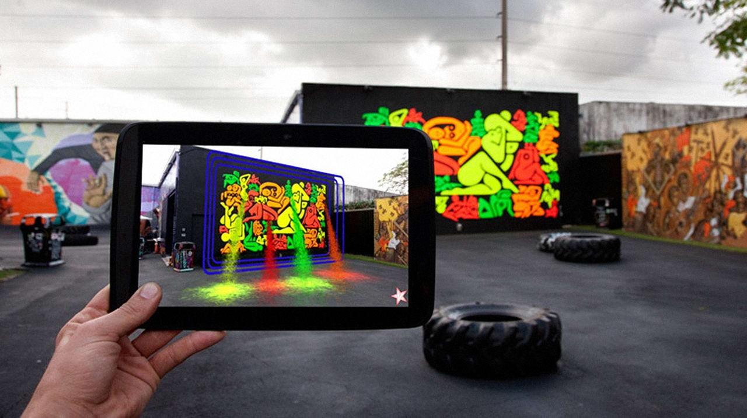
Augmented Reality in Art

Slide 12
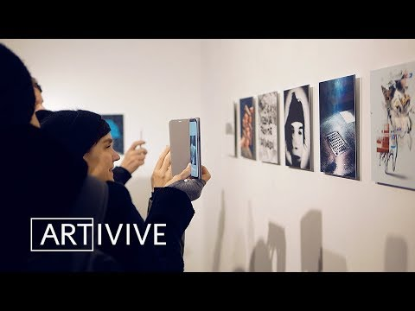
Augmented Reality in Art

Slide 13
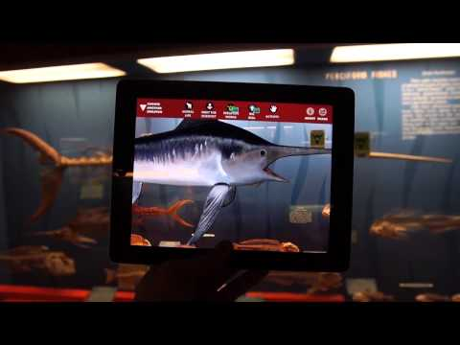
Augmented Reality in Art

