Slide 1
Engaging RéSuméS
Adding video Intros with QR Codes

Slide 2
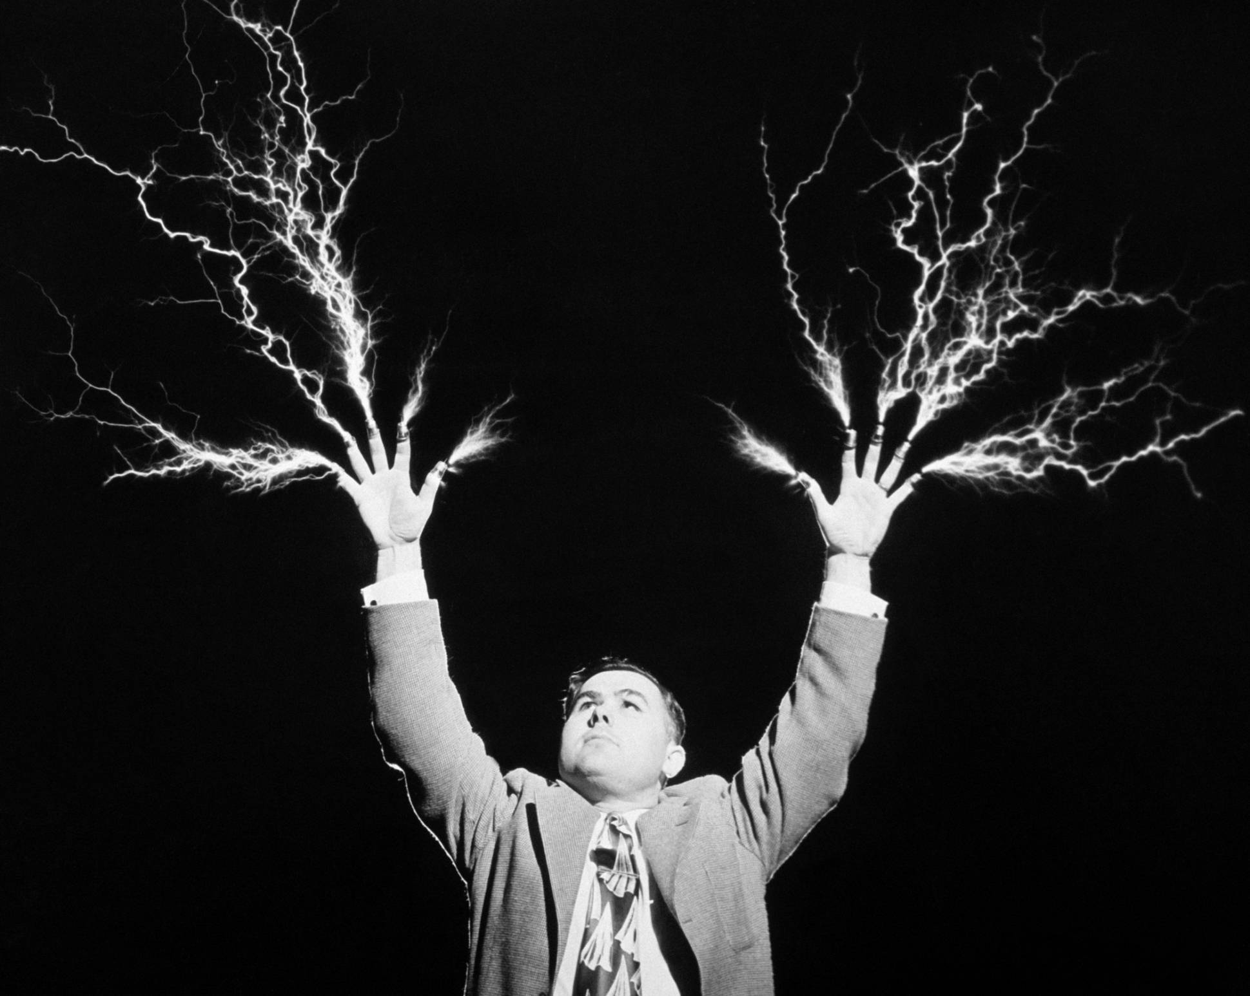
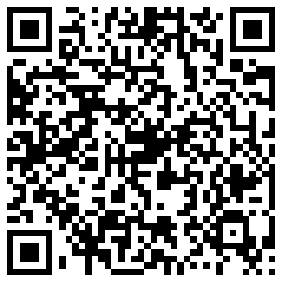
Warning: ExpLoratory Workshop

Slide 3
What Is the Media Commons?
Resources: equipment, space and people
Community: on campus and across Penn State system

Slide 4
Shoot Your Intro
Borrow a camera from Media Commons – or use your own webcam
Stage your set in the MC studio, at home or at work
Light yourself well
Dress the part
Prepare a script - but try not to read it on camera

Slide 5
Edit Your Intro
Trim out the bad takes, redos and unwanted materials
Be as concise as possible
Adjust audio
Add in supporting titles, graphics, etc.

Slide 6
Upload Your Intro
Create an account at YouTube or Vimeo
Share > YouTube/Vimeo
Title, describe, tag, etc.
Copy URL

Slide 7
Make a QR Code
Visit qrcode.kaywa.com
Paste in your URL, submit
Drag the generate code image to desktop

Slide 8
Also…
Use QR code for portfolio site
Add intro to professional profile
Place QR codes on business cards

Slide 9
Questions
In person here today for general and specific questions
By phone at the hotline 1-866-266-7496
By email at mediacommons@psu.edu
On our website at http://mediacommons.psu.edu
Directly using the information on my card

